Slide 1
5 – Clean Code – Form
Based on the CleanCoders videos by Uncle Bob Martin
Rupert Waldron

Slide 2
Comments
When organisations get to a certain size a document will appear…. The Coding Standard. Everyone should follow this, but it shouldn’t be in a separate document, it should be implicit in the code.
When comments are required in the code, they tend to be ignored.
Comments should be rare and should be communicate important information.
The best documentation – clean structure and good formatting. The only reliable documentation of a program is the code.
Purpose of a comment is to explain the code that cannot be explained by the code itself – every comment is a failure to express yourself in code.

Slide 3
Comments
Over time the comments degrade into miss-information and lies.
Comments rot, mainly because their scope is not local, how do you know there isn’t a comment somewhere else saying the opposite. This uncertainty means developers are reluctant to update them even after the code has changed… in short the comments rot.
Good Comments
Legal comments
Comments that describe a regular expression
Warning comments
Public Api docs – the best public Api documents is the documentation you don’t have to write.

Slide 4
Good Comments
Legal comments
Comments that describe a regular expression
Warning comments
Public Api docs – the best public Api documents is the documentation you don’t have to write.
Make sure your comment refer to the code it is next to
Better still… use explanatory names for class, functions and variables

Slide 5
Bad Comments
/** * Default constructor */ public BadComments() { }
/* x is incremented by one it is called pre-increment first increase the value of x by 1 and then use it */ x++;
/** The name */ private String name;
// Returns x + y or, if x or y is less than zero, throws an exception public int Add(int x, int y) { return x + y; }
/* Added by Rick */ public class BadComments {
/** * Adds two integers together * @param x * @param y * @return the sum of two integers */ public int Add(int x, int y) {
/* set the value of the age integer to 32 */ int age = 32;
/* * Replaces with spaces * the braces in cases * where braces in places * cause stasis. **/ $str = str_replace(array("\{","\}")," ",$str);
/** Dear maintainer: Once you are done trying to 'optimize' this routine, and have realized what a terrible mistake that was, please increment the following counter as a warning to the next guy: total_hours_wasted_here = 42 **/ public int solve(int... ints) {
//********************* // Instance Variables //*********************
/* This code sucks, you know it and I know it. Move on and call me an idiot later. */
If you see these comments in code – DELETE THEM
/** * Do stuff in pet shop * * @param petToSell * @param exercisePets * @param goOnHoliday */ public void runShop(String petToSell, boolean sellPet, boolean exercisePets, boolean stockAPet, String petToStock, boolean goOnHoliday) {
/** sets port on which application should run */ public void setPort(int port) {
Out of scope comments

Slide 6
Category | Good or Evil? | Why?
Explaining complicated code (“what” or “how”) | 95% Evil | Typically indicative of code that should be rewritten, obviating the need for such comments. Clutters the code unnecessarily. Increases maintenance costs. Becomes inaccurate and worse, misleading, over time.
Repeating the code in different words | 100% Evil | Adds no value to the reader. Violates DRY (Don’t Repeat Yourself). Clutters the code unnecessarily. Increases maintenance costs. Becomes inaccurate and worse, misleading, over time.
Markers (e.g. “to do” tags) | 25% Evil | When used consistently allows easy searching of unfinished items required for release. Make sure that those associated with items required for release are removed before release; OK to keep others around.
Explaining code rationale (the”why” of the code) | 0% Evil | Summary or intent comments help show the bigger picture. Use to explain why choices were made or how broken conventions are necessary for performance or compatibility, etc.
Resource inclusion | 0% Evil | Describe particulars that cannot be expressed by code, including references, legal notices, provenance, etc.
Witticisms (self-indulgent comments) | 75% Evil | Cute at the moment you write it but chances are even you (let alone a colleague) would not understand it a week later. Sometimes, though, it is fun to have a chuckle when you read some code.
API doc-comments | 25% Evil | Good when well-written; providing useful information. Not so good when providing no useful information.
Commented-out code | 100% Evil | Useful in the heat of coding for debugging or experimentation, but should be used as a temporary measure only.
Syntax Extension | 50% Evil | Typically frowned upon but necessary on occasion for backwards compatibility

Slide 7
Formatting – first thing someone sees
Use white space and blank lines strategically
Big projects do NOT imply big files (Smaller is better)
Most files should be 200 lines or less with a max file size of 500 lines
Use blank lines to separate topics or processes in code. Things that are related to each other should be closed to each other
Separate variable declaration from functional code in a method
Separate with blank lines parts of processes in a function
If a group of variables are related to same topic group them together but separate them from others that are used for a separate topic or process
private boolean isPalindrome(BigInteger num) { String digits = num.toString(); int lastIndex = digits.length() - 1; for (int i = 0; i < digits.length(); i++) { if (digits.charAt(i) != digits.charAt(lastIndex - i)) return false; } return true; }
Things that are closely related should be grouped together vertically

Slide 8
Horizontal Formatting
Length of lines of code should be of any length as long as you don't have to scroll right to see (max 100 or 120 characters)
You should never have to scroll to the right

Slide 9
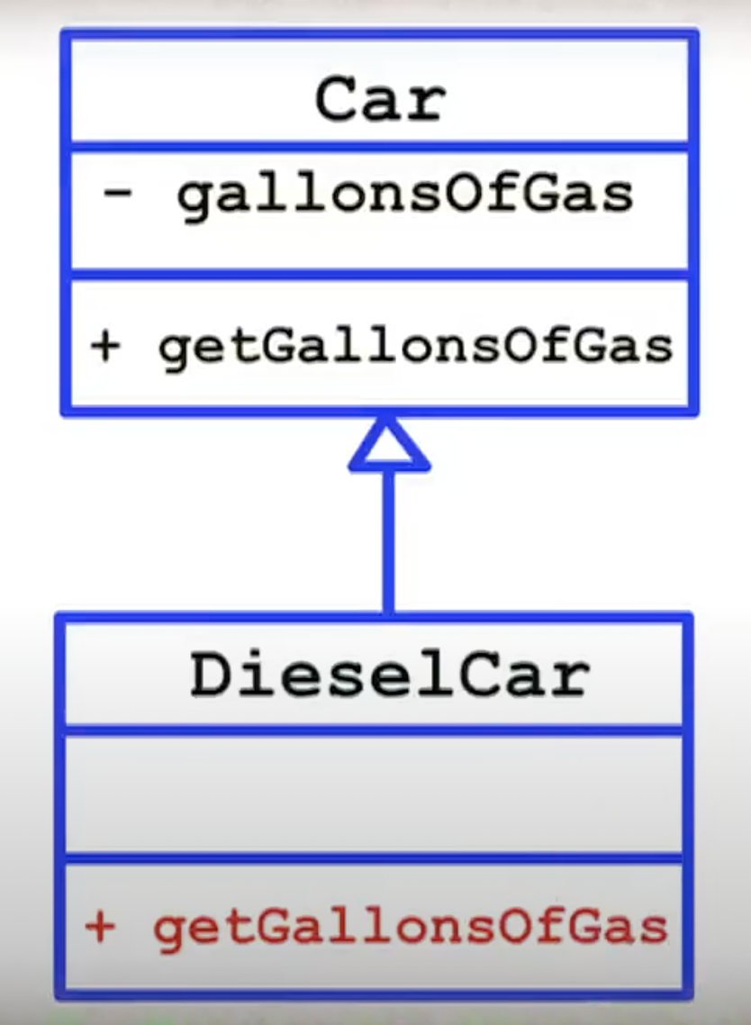
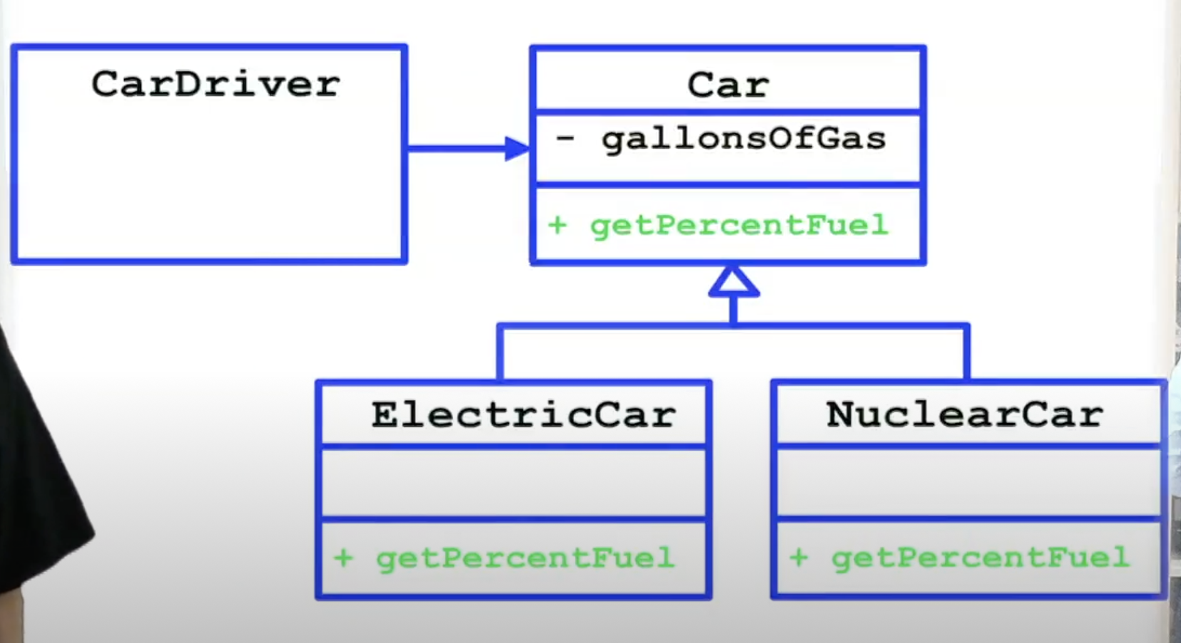
Classes – Public methods and private variables
Classes are containers of methods/functions that hide the implementation of the data they manipulate
Minimize getters and setters in class and try to maximize cohesion
Don't just expose variables through simple getters, abstract information you want to expose
Methods operate on data but tell you nothing about how that data is implemented, when they expose data they exposed in the most abstract way
Don’t expose the implementation
Derivatives now fit with the base
Now car driver can drive any derivative of car

Slide 10
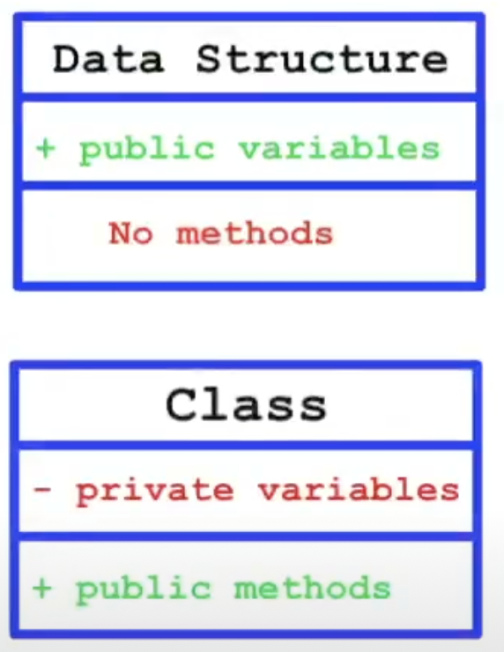
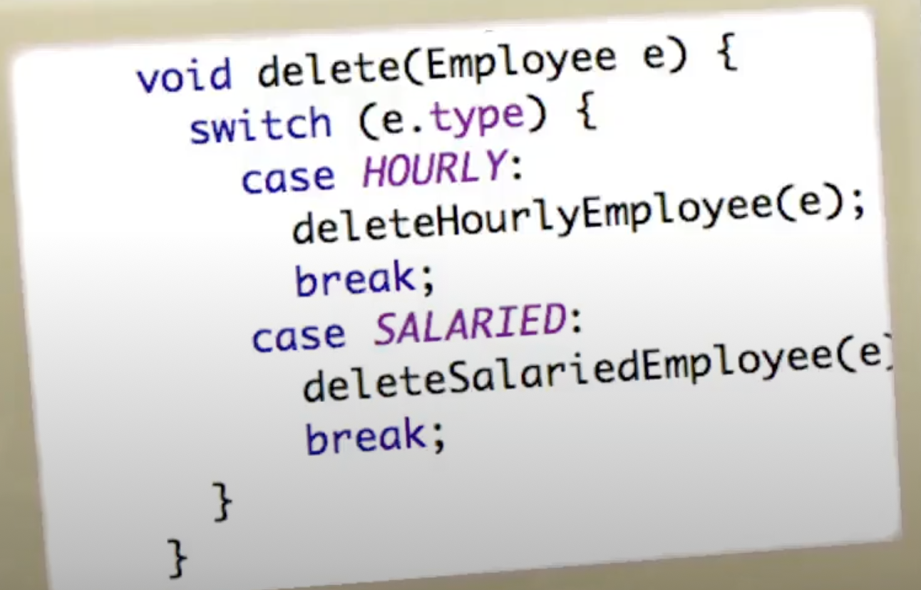
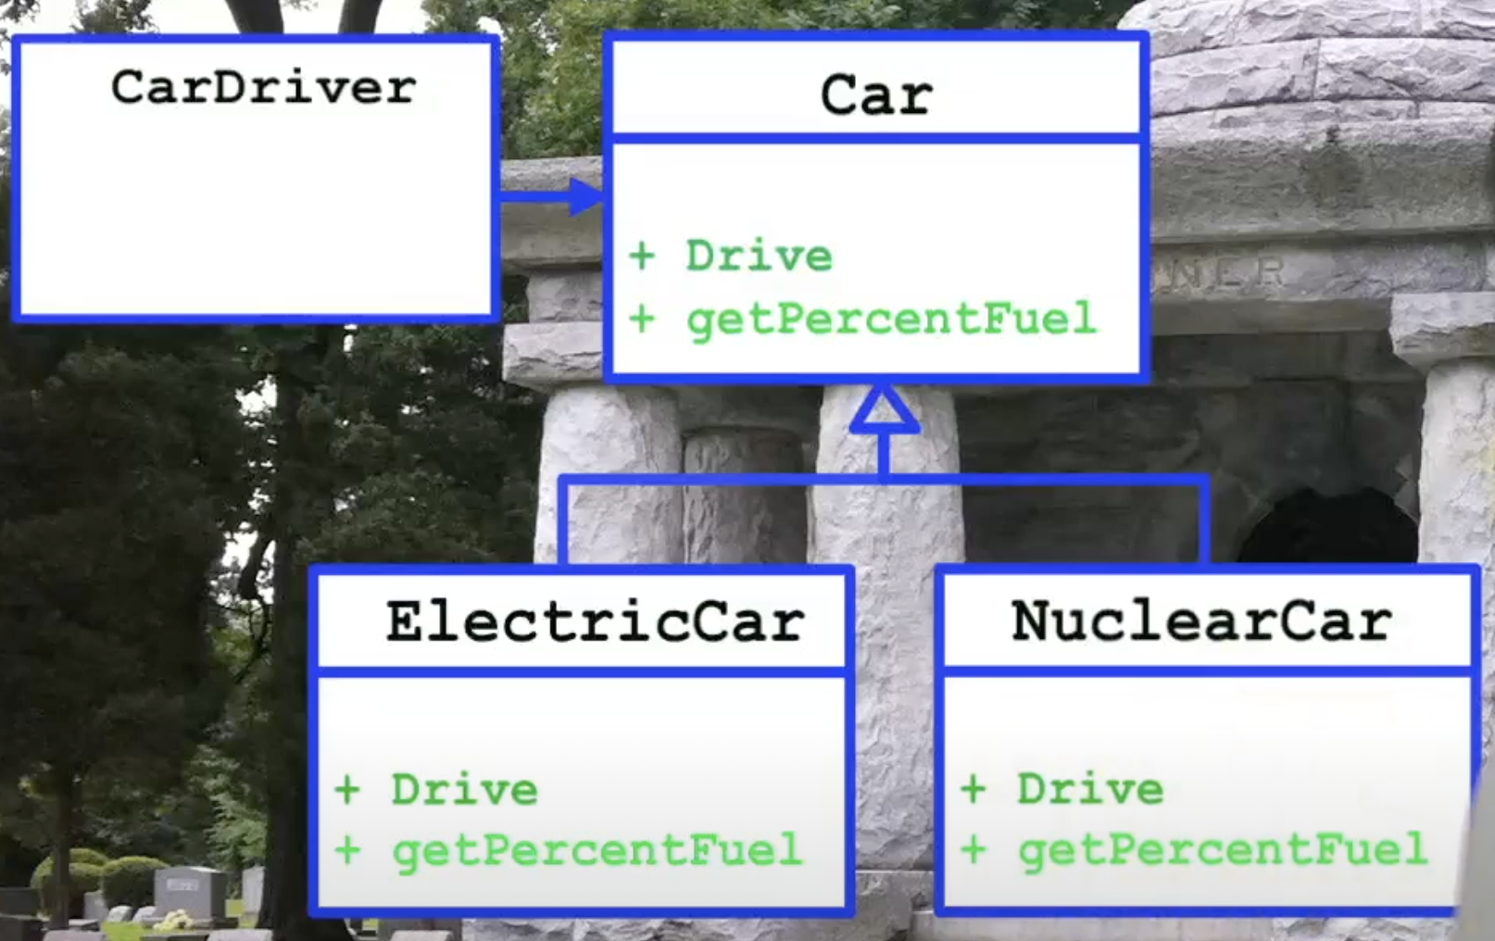
Data Structures – public variables and no methods
You can’t tell a data structure to do anything – you can just ask it questions. The opposite of “Tell Don’t Ask”. Then you would have to dispatch to the correct method yourself – normally through the use of a switch statement.
You can ask a class to do something and it will polymorphically dispatch to the correct method.
Data Structure -> Switch statements
Switch statements expose us to changes in types.
When a new method is added you just add a new switch, nothing else need change.
Classes -> Polymorphism
Classes protect us from changes to types, but expose to adding methods to the base class. All the derivatives will be affected.
Go to the shape code…

Slide 11
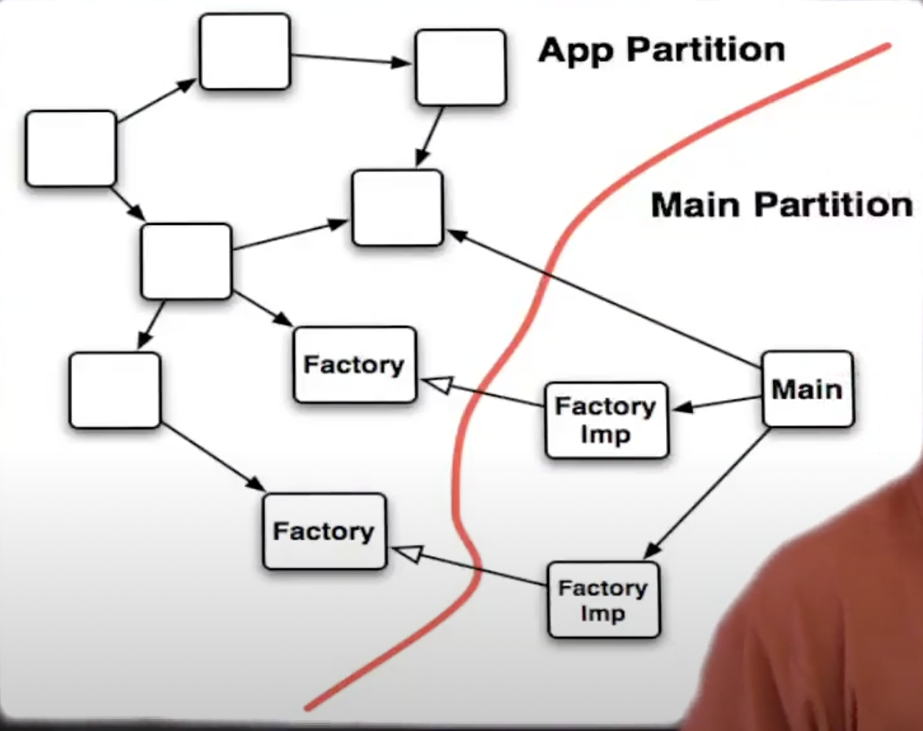
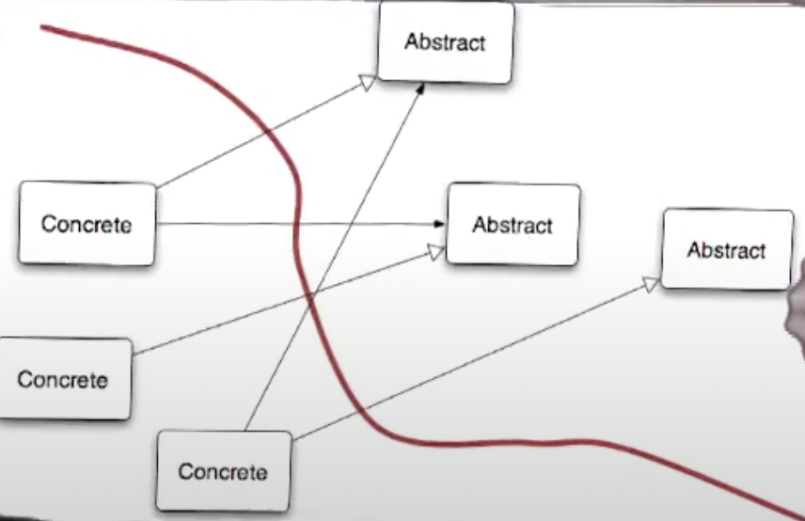
Boundaries
The arrows should cross the boundary in one direction
The arrows should go from concretions to abstractions

